Slide 1
Virtual Open House
English 7- Ms. Gonzalez -Room 112

Slide 2
Welcome to Virtual Open House
Due to our current circumstances, unfortunately we are unable to have a regular Open House this year.
I wanted to share with you just a couple of things from our class, and allow you to have a discussion with your child about a few items from English.
Click on through the next couple of slides and enjoy this version of Open House!

Slide 3
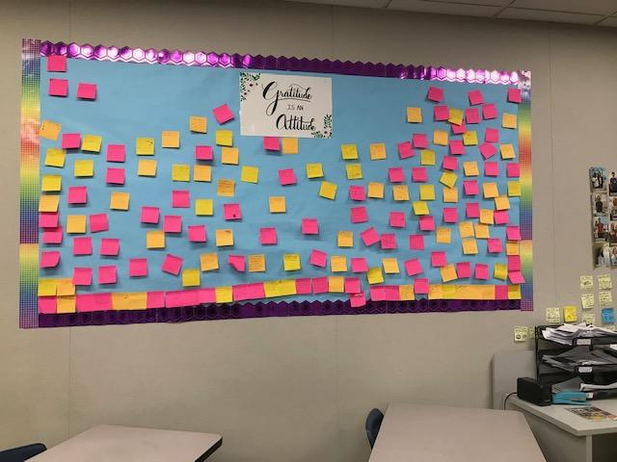
Gratitude is an Attitude
We did a unit on gratitude recently. After we concluded the unit, I had students write on a Post-it note something they were grateful for. Every class period posted a note on our wall!
Ask your child a few concepts/ideas he or she learned from the gratitude unit.
Also, have a discussion about what you and your family are grateful for.

Slide 4
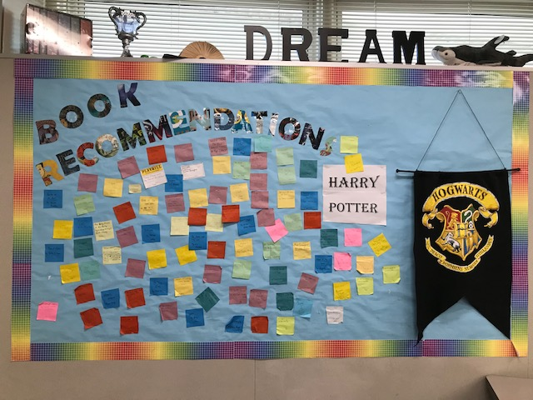
Book Recommendations
Every student has done independent reading all year long!
Ask you child what book or books they have enjoyed reading for their independent reading and why.
Also, discuss a few book recommendations with one another. I would love to know more book recommendations that we can add to our class wall.

Slide 5
Persuasive Letter
Currently your child is working on writing a persuasive letter to a person, company, organization, cause, etc. to try and convince them of their idea. Discuss with your child their thesis (purpose) from their letter.
Next, have your child explain the Methods of Persuasion to you, and ask them which methods they are using for their persuasive letter.
Also, discuss with your child a time YOU used some methods of persuasion in life.

Slide 6
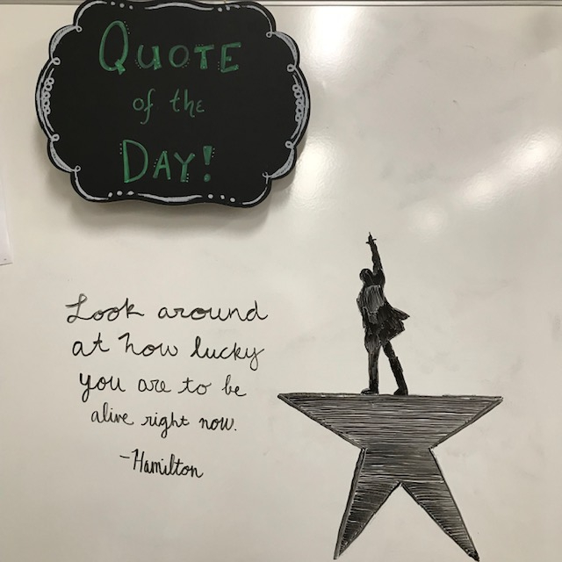
Thank you!
Thank you for visiting the Virtual Open House for Ms. Gonzalez’s 7th grade English class!
I hope you are all doing well! Take care!
This photo is from our class “Quote of the Day” board from earlier in the year.

