Slide 1
Goodreads Prompts
2019-2020

Slide 2
Goodreads Prompt 9/9- Protagonist
Definition: The protagonist of a story is the main character, the character who leads the reader through the story. (Ex. Luke Skywalker, Katniss Everdeen, Ishmael Beah, etc.)
Prompt: Describe the protagonist of the story you’re reading. You should describe his or her appearance, actions, words, thoughts, and feelings. You should also include what others say about this character.
  If there is no obvious protagonist, consider: the protagonist may be a thing and not a person. If there is more than one protagonist, choose one to describe. If you’re reading a non-fictional book there should still be a “protagonist” the main person being discussed. If there is not, you might be reading more of a “text book”or a “how to manual” type of non-fiction and you will want to reconsider your independent reading choice in order to fulfill your goodreads assignments.
Be sure to also include how many pages you read this past week in your comment. Make sure you type your response on Google Docs or the Pages app before you copy and paste it to the goodreads site. Spelling, grammar, punctuation, capitalization all count. Remember, you are copying and pasting your comment in the “comment” section on the goodreads site.

Slide 3
Goodreads Prompt 9/16- Summary
Write a summary of what has happened in your book based off of what you read this past week.
  To do this, discuss the most important events, overall setting, and conflicts. You do not want to write every little thing that has happened because that would not be a summary. You want to give enough information to show you have been reading, so you do want to mention specific details.
Be sure to also include how many pages you read this past week in your comment. Make sure you type your response on Google Docs or the Pages app before you copy and paste it to the goodreads site. Spelling, grammar, punctuation, capitalization all count. Remember, you are copying and pasting your comment in the “comment” section on the goodreads site.

Slide 4
Goodreads Prompt 9/23- Setting
Definition: The setting is both the time and place.
  A location in the book is not the overall setting; it is a location of a scene. These matter as well, but the setting is the “larger” area where that location is. Example-A rural town in Mississippi during the 1930’s
Prompt: Describe the setting of the story you are reading and explain the impact (effect/power) that setting has on the story. Make sure you give specific details to show you are reading. Do not be vague. To determine the impact, think about how the story might be different if it took place at a different place or a different time.
Be sure to also include how many pages you read this past week in your comment. Make sure you type your response on Google Docs or the Pages app before you copy and paste it to the goodreads site. Spelling, grammar, punctuation, capitalization all count. Remember, you are copying and pasting your comment in the “comment” section on the goodreads site.

Slide 5
Goodreads Prompt 10/7- Conflicts
Prompt: What are the conflicts in your story? Describe at least two and explain the type of conflict. Help your explanation by using textual evidence to support your response. Make sure you explain how the piece of evidence supports your type of conflict. Be sure to include how many pages you have read this past week. Type your response in Pages or Google Docs before you copy and paste it to Goodreads.
Definition: There are 5 main types of conflict:
  character v. character
    (Harry v. Voldemort)
  character v. self
    (Simba struggles with his fate as king of the lions and the death of his dad)
  character v. society
    (Katniss fights to change the society she lives in)
  character v. technology
    (fighting robots that want to take over the world)
  character v. nature
    (Brian, from the book Hatchet, struggles to survive alone in the wilderness)

Slide 6
Goodreads Prompt 10/14- Connections
Remember good readers make connections while they read. These connections are described as:
  Text to text– between a text and another text
  Text to self– between the text and the reader’s own life
  Text to world– between the text and the news or history
What connections have you made, or can you make, between your book and another text, yourself, or the world? Choose two of the connections to discuss in your comment. Make sure to explain. Give details and/or use evidence from your book to support your connection and to show you are reading your independent book.
  Also, make sure to include how many pages of independent reading you did this week and type your response in Pages or Google Docs first. Be sure to Proofread for grammar, spelling, capitalization, etc. errors before you copy and paste it to the Goodreads site.

Slide 7
Goodreads Comment 10/21- Minor/Supporting Character
Definition- a minor/supporting character is not a main character, but still plays an important role in a story. These characters don’t tend to transform/change, but their actions help move the plot forward, and they often influence the choices (good or bad) the main character makes in a story. Examples (Samwise Gamgee, Ron Weasley, Cinna)
Prompt- Describe one minor character in your book. Be sure to explain specifically what role that character plays in the story. Give a couple of examples from the text for evidence and explain how the examples reveal that this character is an example of a minor character. Make sure to include how many pages you read this past week. Type your response on Google Docs or Pages before you copy and paste it to the Goodreads site to complete your assignment.
Guided Questions to help you answer the prompt:
  What role does this character play? Consider that the author does everything for a reason. What is the reason, or purpose, of this character in the story? Do they help? Are they a distraction? A good influence? A bad influence? Sometimes characters play the role of conscience, or wisdom, or loyalty.

Slide 8
Goodreads Prompt 11/4- Characterization
Definition- Remember, characterization refers to the way an author reveals characteristics (traits) of a character to the reader. There are 5 main ways that an author teaches us about a character:
  What the character says
  What the character does
  What the character looks like
  What the character thinks and feels
  What others say about the character
Prompt- Consider an action, dialogue, and feelings that one character has done and felt in your current book. What does that action reveal about the character from the book? Use textual evidence to support your response. Be sure to explain and give details how this evidence reveals the character trait? Why does this matter to the character or to the theme of the book? Explain.
Also, make sure to include how many pages of independent reading you did this week and type your response in Pages or Google Docs first. Be sure to Proofread for grammar, spelling, capitalization, etc. errors before you copy and paste it to the Goodreads site.

Slide 9
Goodreads Prompt 11/12- Summary
Write a summary of what happened in chapter 10 of Roll of Thunder, Hear My Cry.
  Be sure to discuss the most important events, overall setting, and conflicts. You do not want to write every little thing that has happened because that would not be a summary. You want to give enough information to show you read the chapter, so you do want to mention specific details.
Be sure to include how many pages you have read this week of your independent book in your comment that you will post. Make sure you type your comment in the Pages App or Google Docs first, so you can proofread before you copy and paste it onto the Goodreads website

Slide 10
Goodreads Prompt 11/18- Book Review
Write an honest review of Roll of Thunder, Hear My Cry. Remember, a review is your overview opinion of the book. Use the following questions to help you write your review. Be sure to type your response in the Pages App or Google Docs to edit and proofread before you copy and paste it to Goodreads. Also, be sure to include the amount of pages you read of your independent reading book this past week.
Questions for your review:
  Did you like the book? Why or why not? What was good about it? Did any parts make you laugh? Were you frustrated at any parts of the novel because of the plot? Explain.
  Did you dislike the book? Why or why not? Explain.
  What was your favorite part of the story? Why? Explain.
  Discuss the main character(s)- were the characters authentic, unbelievable, boring, or relatable? Did the characters make good choices, unrealistic choices, or obvious choices? Explain.
  Were the conflicts boring, suspenseful, predictable? Explain.
  What group of people would like this book? Explain.
  Would you recommend this book? Why or why not? Explain.

Slide 11
Goodreads Prompt 12/2-Response
Personal responses are an important form of writing. It allows a reader to connect to the text and express their thoughts and reactions in written form. For your Goodreads comment this week, I want you to respond to your independent novel you’ve been reading or just finished. Be sure to explain enough to show you have done your reading. Make sure you type a draft on Pages before you copy and paste it to the site. Also, make sure you include how many pages you read the week before break.
Use the following questions to help create your response:
  What is your opinion about what happens in your book? This could be a specific chapter or scene. Explain.
  How do you feel about the events? (angry, confused, happy, anxious, etc.) Explain.
  What are you questioning about the plot (the events)? What are you questioning about character choices or author choices? Explain.
  What predictions can you make? Explain. If you finished your book, you don’t need to answer this question.
  What changes would you make in the book? Why?
  Do you agree with the main character’s decisions? Why or why not? Do you think these choices will cause conflicts for the character or other characters in the future? Explain.

Slide 12
Goodreads Prompt 12/9- Summary
Write a summary of what has happened in your book based off of what you read this past week.
  To do this, discuss the most important events, overall setting, and conflicts. You do not want to write every little thing that has happened because that would not be a summary. You want to give enough information to show you have been reading, so you do want to mention specific details.
Be sure to also include how many pages you read this past week in your comment. Make sure you type your response on Google Docs or the Pages app before you copy and paste it to the goodreads site. Spelling, grammar, punctuation, capitalization all count. Remember, you are copying and pasting your comment in the “comment” section on the goodreads site under the section that says “My Activity”

Slide 13
Goodreads Prompt 1/6 - Conflicts
Prompt: What are the conflicts in your story? Describe at least two and explain the type of conflict. Help your explanation by using textual evidence to support your response. Make sure you explain how the piece of evidence supports your type of conflict. Be sure to include how many pages you have read the last week before the break/over the break. Type your response in Pages or Google Docs before you copy and paste it to Goodreads.
Definition: There are 5 main types of conflict:
  character v. character
    (Harry v. Voldemort)
  character v. self
    (Simba struggles with his fate as king of the lions and the death of his dad)
  character v. society
    (Katniss fights to change the society she lives in)
  character v. technology
    (fighting robots that want to take over the world)
  character v. nature
    (Brian, from the book Hatchet, struggles to survive alone in the wilderness)

Slide 14
Goodreads Prompt 1/13- Connections
Remember good readers make connections while they read. These connections are described as:
  Text to text– between a text and another text
  Text to self– between the text and the reader’s own life
  Text to world– between the text and the news or history
What connections have you made, or can you make, between your book and another text, yourself, or the world? Choose two of the connections to discuss in your comment. Make sure to explain. Give details and/or use textual evidence to support your connection and to show you are reading.
  Be sure to include how many pages of independent reading you did this week and type your response in Pages or Google Docs first. Be sure to Proofread for grammar, spelling, capitalization, etc. errors.

Slide 15
Goodreads Prompt 1/21- Characterization
Remember-characterization refers to the way an author reveals characteristics (traits) of a character to the reader. There are 5 main ways that an author teaches us about a character:
  What the character says
  What the character does
  What the character looks like
  What the character thinks and feels
  What others say about the character
Consider an action, dialogue, and feelings that one character has done and felt in your current book. What does that action reveal about the character from the book? Use textual evidence (you may quote or paraphrase) to support your response. Be sure to explain and give details how this evidence reveals the character trait? Why does this matter to the character or to the theme of the book? Explain.
  Also, be sure to include how many pages you read over the past week. Type this in Google Doc or Pages before you copy and paste it to the Goodreads site.

Slide 16
Goodreads Prompt 1/27- Sympathetic and Unsympathetic Characters
A sympathetic character is likable; a character you understand, you relate to, you respect his or her choices. It’s a character who you care about, and who evokes feelings of sympathy. (Ex-Katniss or Hermione)
An unsympathetic character is someone who you don't like, or know well enough to like. Perhaps this character makes choices you don't understand, respect, or appreciate. (Ex- President Snow or Count Olaf)
  Sometimes an unlikeable character is sympathetic– you can understand a person without agreeing with them or liking them. (Ex- Snape)
  Often an unsympathetic character becomes sympathetic-– something happens that makes you understand him or her. (Ex- Scrooge or Darth Vader)
Write about a sympathetic and/or an unsympathetic character in your current book. Explain why the character is this way. Be sure to give specific details to support your answer. Also, include the amount of pages you read this week. Remember, to type in the Pages App or Google Docs first before pasting it on the Goodreads site.

Slide 17
Goodreads Prompt 1/27- Sympathetic and Unsympathetic Characters
A sympathetic character is likable; a character you understand, you relate to, you respect his or her choices. It’s a character who you care about, and who evokes feelings of sympathy. (Ex-Katniss or Hermione)
An unsympathetic character is someone who you don't like, or know well enough to like. Perhaps this character makes choices you don't understand, respect, or appreciate. (Ex- President Snow or Count Olaf)
  Sometimes an unlikeable character is sympathetic– you can understand a person without agreeing with them or liking them. (Ex- Snape)
  Often an unsympathetic character becomes sympathetic-– something happens that makes you understand him or her. (Ex- Scrooge or Darth Vader)
Write about a sympathetic and/or an unsympathetic character in your current book. Explain why the character is this way. Be sure to give specific details to support your answer. Also, include the amount of pages you read this week. Remember, to type in the Pages App or Google Docs first before pasting it on the Goodreads site.

Slide 18
Goodreads Prompt 2/3- Response
Remember, personal responses are an important form of writing. It allows a reader to connect to the text and express their thoughts and reactions in written form. For your Goodreads comment this week, I want you to respond to the pages that you have read from the past week. Be sure to explain enough to show you have done your reading. Include how many pages you have read this past week. Make sure you type a draft on Pages or Google Docs before you copy and paste it to the site.
Use the following questions to help create your response:
  What is your opinion about what happens in the pages you’ve read? Explain.
  How do you feel about the events? (angry, confused, happy, anxious, etc.) Explain.
  What are you questioning about the plot (the events)? What are you questioning about character choices or author choices? Explain.
  What predictions can you make? Explain.
  What changes would you make in the book? Why?

Slide 19
Goodreads Prompt 2/10- Summary
Write a summary of what has happened in your book based off of what you read this past week.
  To do this, discuss the most important events, overall setting, and conflicts. You do not want to write every little thing that has happened because that would not be a summary. You want to give enough information to show you have been reading, so you do want to mention specific details.
Be sure to also include how many pages you read this past week in your comment. Make sure you type your response on Google Docs or the Pages app before you copy and paste it to the goodreads site. Spelling, grammar, punctuation, capitalization all count. Remember, you are copying and pasting your comment in the “comment” section on the goodreads site under the section that says “My Activity”

Slide 20
Goodreads Prompt 2/24- Imagery
Imagery is the literary term that writers use to appeal to our five senses: smell, sight, taste, touch, or hearing. Often, imagery is built on other literary devices such as figurative language (similes, metaphors, allegories, etc). The author uses figurative language as comparisons to appeal to our senses.
  Think of when a movie starts to play in your head when you are reading. You can almost see, taste, touch, smell, feel what the author has described- when this happens you know the author is using imagery.
  Example- “I could hear the popping and crackling as mom dropped the bacon into the frying pan, and soon the salty, greasy smell wafted toward me.” Think of how this example plays a movie in your head. What senses does this example appeal to? Discuss with your writing partner.
Find a few examples of imagery in your current book (non fiction uses this as well). Make sure to use textual evidence (or paraphrase an area if you do not have your book with you) where the author uses imagery. Be sure to explain why it’s an example of imagery and what sense(s) you felt reading these examples.
Do not forget to include how many pages you read the week before the break and/or during the break. Make sure to type in Google Docs or Pages first to proofread before you copy and paste it to the site.

Slide 21
Goodreads Prompt 3/2-Minor/Supporting character
Definition- a minor/supporting character is not a main character, but still plays an important role in a story. These characters don’t tend to transform/change, but their actions help move the plot forward, and they often influence the choices (good or bad) the main character makes in a story. Examples (Samwise Gamgee, Ron Weasley, Cinna)
Prompt- Describe one minor character in your book. Be sure to explain specifically what role that character plays in the story. Give a couple of examples from the text for evidence and explain how the examples reveal that this character is an example of a minor character. Make sure to include how many pages you read this past week. Type your response on Google Docs or Pages before you copy and paste it to the Goodreads site to complete your assignment.
Guided Questions to help you answer the prompt:
  What role does this character play? Consider that the author does everything for a reason. What is the reason, or purpose, of this character in the story? Do they help? Are they a distraction? A good influence? A bad influence? Sometimes characters play the role of conscience, or wisdom, or loyalty.

Slide 22
Goodreads Prompt 3/9- Summary
Write a summary of what has happened in your book based off of what you read this past week.
  To do this, discuss the most important events, overall setting, and conflicts. You do not want to write every little thing that has happened because that would not be a summary. You want to give enough information to show you have been reading, so you do want to mention specific details.
Be sure to also include how many pages you read this past week in your comment. Make sure you type your response on Google Docs or the Pages app before you copy and paste it to the Goodreads site. Spelling, grammar, punctuation, capitalization all count.

Slide 23
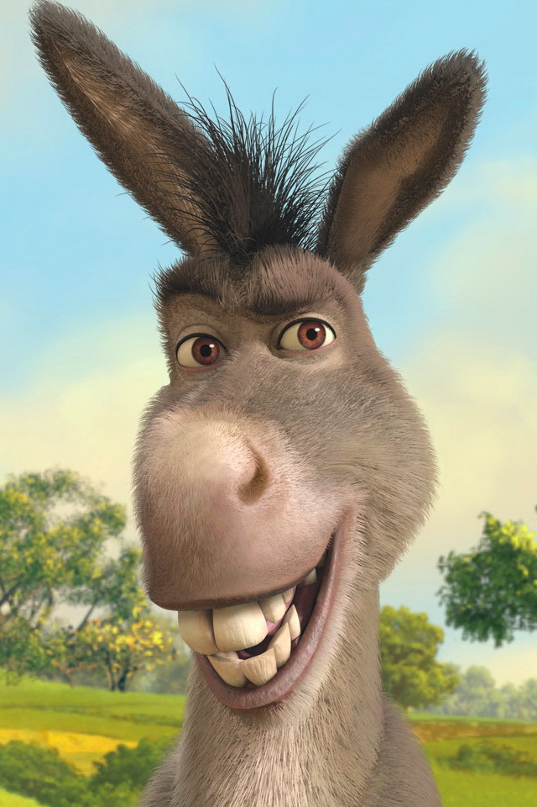
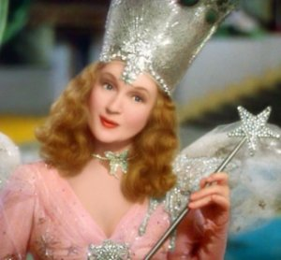
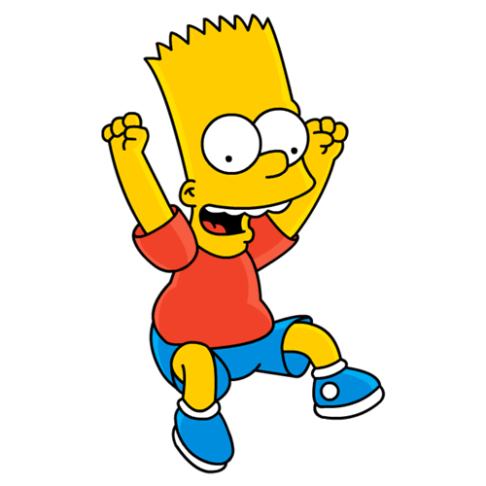
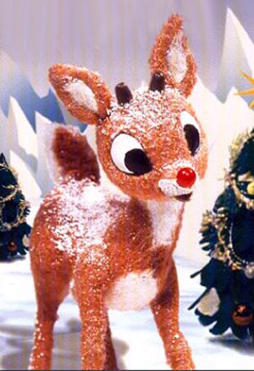
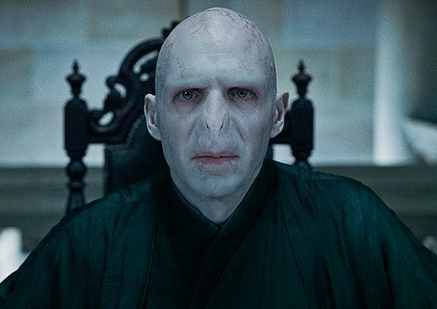
Goodreads Prompt 3/16 and 3/17-Character Archetypes
Character types that occur over and over are called archetypes. An archetype is a typical character, an action, or a situation that seems to represent universal patterns of human nature. We know and understand these character types and see them sometimes in our real lives.
For example, Yoda is the archetype of the mentor. Neville in Harry Potter or Belle from Beauty and the Beast are the archetypal outcast. Prim and Rue in The Hunger Games are the innocent. Tom Sawyer is a trickster.
This week write about two characters from your book. Be sure to state what archetype you believe each character is and explain, with examples, why the character fits the role.
Make sure you type your response in Pages or Google Docs first before you copy and paste it on Goodreads. Be sure to include the amount of pages you read this week.
The Hero | The Sidekick | The Mother Figure
The Mentor | The Innocent | The Trickster
The Outcast | The Caretaker | The Villain
Archetypes ppt

