Slide 1
Gratitude is an Attitude
Thank You Unit

Slide 2
What are your Strengths?
Before we discuss this idea of gratitude, we are going to focus on YOU. Specifically, what are some of your top strengths?
Character strengths are personal qualities, like honesty and leadership that help you get along in the world and be a better person. People tend to be stronger at a few of these virtues than others. Knowing your character strengths and using them can help you be happier and more successful in the world.

Slide 3
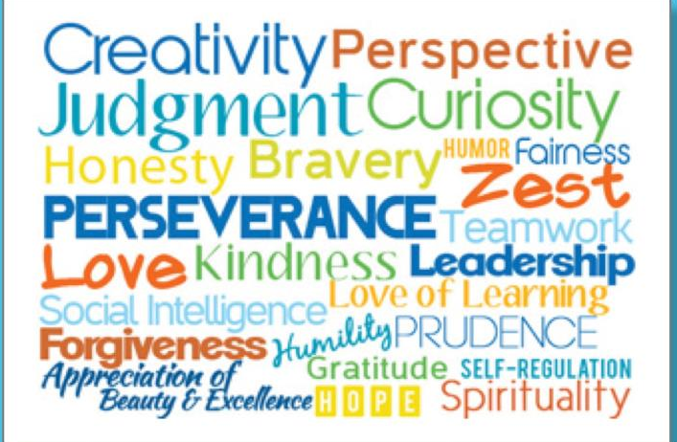
What do you think are your top 3?
Write them in your Writer’s Notebook.

Slide 4
The Science of Character
https://www.youtube.com/watch?v=U3nT2KDAGOc

Slide 5

Take the quiz
Head to jawesomenglish.com to the daily agenda section to open the link for the quiz. You will want to open it in Notability to be able to mark on it.

Slide 6
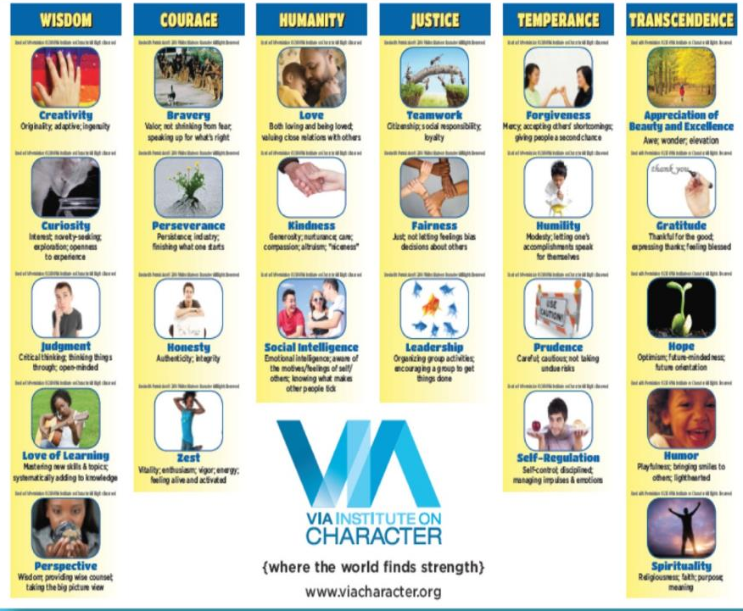

Slide 7
Discuss how you can each use one of your top strengths to help others or society? For example, if you score high in creativity, then you could use it to create music. If a strength is kindness, how might you encourage others to be kind? Think about your strengths and don’t just say “I don’t know.”
After a few minutes of discussion, write or draw in your writer’s notebook a few ideas you came up with or even something else you’re thinking of now.

Slide 8
Homework
For Homework, Google search the term “gratitude science.” Read the article and annotate for main ideas. You may print it out and annotate on the article OR you may import the article to Notability and annotate on your device.
Be prepared to discuss this with your small group tomorrow.

Slide 9
Part 2
What does gratitude mean? Explain and give examples to help define the term.
Write in your writer’s notebook for a few minutes. We will share out some responses.

Slide 10
Gratitude defined
Gratitude is the ability to recognize and acknowledge the good things, people, and places in our lives.
  For example, if your friend goes out of their way to do you a favor, you would probably feel grateful towards them.

Slide 11
Nature. Beauty. Gratitude
https://www.ted.com/talks/louie_schwartzberg_nature_beauty_gratitude

Slide 12
Science has discovered…
  The effects of Gratitude:
      Gratitude is a positive emotion, so it feels good to be grateful. Positive emotions like gratitude can also make you feel more open, creative, and energized.
      Second, feeling grateful has been linked to physical health outcomes such as lower blood pressure and stronger immune system functioning.
      Third, because gratitude involves recognizing other people for their kindness, feeling and expressing gratitude can help strengthen relationships.
    Because of all these factors, people who feel and express gratitude more often tend to feel happier overall.

Slide 13
Think and jot
Take a few minutes to Make a list of things or people you are grateful for in your writer’s notebook. We will share out a few of our ideas.

Slide 14
When someone does something kind for you…
Did the person do it on purpose?
There’s a big difference between someone doing something to help you for selfish reasons (like needing a favor later) versus for selfless reasons (like deciding ahead of time to do something helpful just for you).
Did the person’s help benefit you?
Think about it: For someone to help you, he or she has to really think about what you need or want. You wouldn’t be super grateful if someone brought you a tissue when you didn’t need one.
    Finally, what did that act cost the other person?
    We often think of costs in terms of money, but it also includes people’s time and effort. For instance, if your mom gives you a ride to the mall, she not only spends money on gas, but also spends her time, which she could use to do something more fun for her. Altogether, we may feel particularly grateful towards someone who sacrifices his or her own time, money, or effort to do something on purpose that benefits us.

Slide 15
https://www.youtube.com/watch?v=o2VFgHGKzx4

Slide 16
Write something that you discovered about gratitude or that surprised you from the lessons in part 2.
Write about a recent example of kindness in your writer’s notebook that considers what the other person might have sacrificed. Make sure you explain. Elaborate your explanation.
  You may draw symbols or pictures in addition to your written response.

Slide 17
Part 3
In your writer’s notebook-
Write about how you think your attitude determines your decisions, direction, motivation, etc.?

Slide 18
How we focus our minds determines our attitude
It’s important to realize that YOU choose how you look at life and what focus you can take throughout the day. - You can spend all of your time and energy thinking about all the things that go wrong in life, looking at people’s negative characteristics, and doing things to feel better about yourself at the expense of others. - Or you can choose to appreciate all the good things that you have in your life, recognize people’s positive characteristics, and do things that make others feel better about themselves.

Slide 19
Take a few minutes to write in your writer’s notebook…
  What is a struggle or hardship you’ve faced?
  Have you ever not asked for help when you needed it? Why?
  Have you ever overcome a big challenge thanks to someone’s help? Explain.
    What did it COST the person who helped you? (Time? Effort?)
    Why did the person INTEND (want) to help you?
    What talents did he or she see in you?
    How did the person notice?
    How did he or she help or encourage you?
    How did it change you?
    Why did it matter? (VALUE)
    How did this event make you feel?

Slide 20
The Science of Happiness – An Experiment in Gratitude
https://www.youtube.com/watch?v=oHv6vTKD6lg

Slide 21
Write a thank you/gratitude letter
Head to jawesomenglish.com to the daily agenda and click on the link for the instructions for your assignment.

Slide 22
Gratitude Reflection
Now that you have completed your gratitude letter to an adult you are grateful for, I want you to reflect on the Gratitude Unit.
First, I want you to write a short response on your reflection of the unit. What did you enjoy about the Gratitude Unit? What did you learn from it? What is your personal definition of gratitude after having completed your assignment and watching all of the various videos? Be sure to explain and give examples to support your answers.
I also want you to write a short response responding to the older, wise man in the video, “Nature. Beauty. Gratitude.” who suggested we live each day as if it was the first day of our lives but also our last. What does this mean to you? How can you choose to have a grateful attitude in every aspect of your life? How can people live each day as if it’s our first and last day? Explain and give examples to support your answers.
If you read your letter out loud to the person you wrote, write about their response. What did they say or do? How did you feel afterwards? Explain.
  This is at the end of class, so make sure you are on task. Do the best you can to complete each response paragraph and proofread. Make sure you write in pen. I’m looking for thoughtful and thorough responses.

