Slide 1
Summary, Response, Analysis
The three types of academic writing

Slide 2
What is the difference?
Summary: A description of what happens
  Guidelines
    Keep it concise
    Include the most important details only
    Write in your own words and in complete sentences.
  Key Questions
    What happens in the plot?
    What characters are involved?
    What settings are involved?

Slide 3
What is the difference?
Response: Your reaction to what happens
  Guidelines
      This section is very open. You can write about whatever your reaction is to the text. Write in complete sentences.
  Key Questions
  What is your opinion about what happens?
  How can you connect?
  What does this part make you think of?
  What questions do you have about this part?
  What predictions you can make?

Slide 4
What is the difference?
Analysis: Explanation of why it is significant
  Guidelines
    Be thoughtful and thorough
    Write complete sentences
    Make sure you are not simply restating the summary
    Ask yourself : Why does this matter? Why is this important?
  Key Focus Points
  When analyzing literature think about:
    Character development
    Theme
    Conflict
    Tone/mood
    Literary devices
  When analyzing non-fiction think about:
  What the info shows
  What the info teaches
  What universal theme the info connects to and the importance of that connection
  Why the info is important

Slide 5
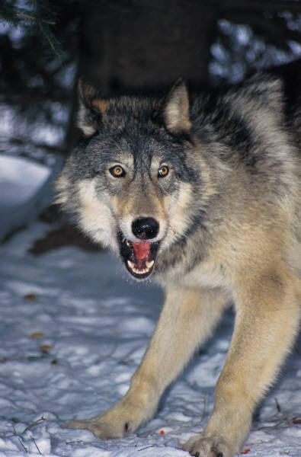
Example: The Boy Who Cried Wolf
SUMMARY | RESPONSE | ANALYSIS
A boy, who watches a flock of sheep near a village, decides to play a prank by crying out, “ Wolf! Wolf!“ When his neighbors come to help him, he laughs at them for falling for the prank. Then one day the wolf does actually come. The boy, now really alarmed, shouts in terror: “Wolf! Wolf!“ This time no one pays attention to his cries and do not come to his aid.

Slide 6
Example: The Boy Who Cried Wolf
SUMMARY | RESPONSE | ANALYSIS
A boy, who watches a flock of sheep near a village, decides to play a prank by crying out, “Wolf! Wolf!” When his neighbors come to help him, he laughs at them for falling for the prank. Then one day the wolf does actually come. The boy, now really alarmed, shouts in terror: “Wolf! Wolf!“ This time no one pays attention to his cries and do not come to his aid. | What is your reaction to the events of this story?

Slide 7
Example: The Boy Who Cried Wolf
SUMMARY | RESPONSE | ANALYSIS
A boy, who watches a flock of sheep near a village, decides to play a prank by crying out, "Wolf! Wolf!“ When his neighbors come to help him, he laughs at them for falling for the prank. Then one day the wolf does actually come. The boy, now really alarmed, shouts in terror: “Wolf! Wolf!“ This time no one pays attention to his cries and do not come to his aid. | What is your reaction to the events of this story? This makes me think of the time my sister kept lying about my brother tackling her, and then when it actually did happen I didn’t believe her I think the boy is wrong to keep playing the trick on the village people.

Slide 8
Example: The Boy Who Cried Wolf
SUMMARY | RESPONSE | ANALYSIS
A boy, who watches a flock of sheep near a village, decides to play a prank by crying out, "Wolf! Wolf!“ When his neighbors come to help him, he laughs at them for falling for the prank. Then one day the wolf does actually come. The boy, now really alarmed, shouts in terror: “Wolf! Wolf!“ This time no one pays attention to his cries and do not come to his aid. | What is your reaction to the events of this story? This makes me think of the time my sister kept lying about my brother tackling her, and then when it actually did happen I didn’t believe her I think the boy is wrong to keep playing the trick on the village people. | Why are the events of this story important? What is the significance of this story?

Slide 9
Example: The Boy Who Cried Wolf
SUMMARY | RESPONSE | ANALYSIS
A boy, who watches a flock of sheep near a village, decides to play a prank by crying out, "Wolf! Wolf!“ When his neighbors come to help him, he laughs at them for falling for the prank. - what a punk - Then one day the wolf does actually come. The boy, now really alarmed, shouts in terror: “Wolf! Wolf!“ This time no one pays attention to his cries and do not come to his aid. | What is your reaction to the events of this story? This makes me think of the time my sister kept lying about my brother tackling her, and then when it actually did happen I didn’t believe her I think the boy is wrong to keep playing the trick on the village people. | Why are the events of this story important? What is the significance of this story? The boy lies so much that nobody believes him when he actually tells the truth. The events of this story are significant because they show the value of honesty. If trust is abused, it is very difficult to earn back.

Slide 10
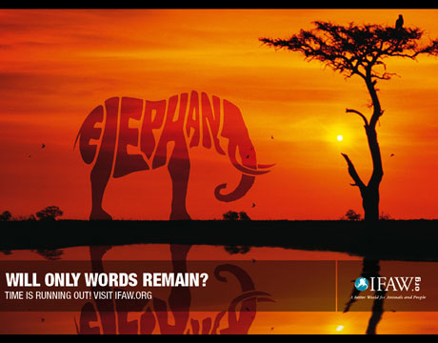
Lets Practice Some More!

Slide 11
Lets Practice Some More!
SUMMARY | RESPONSE | ANALYSIS
A picture of a landscape with a tree and an elephant. The elephant is made up of the letters that spell elephant. The message: “Will only words remain” appears at the bottom.

Slide 12
Lets Practice Some More!
SUMMARY | RESPONSE | ANALYSIS
A picture of a landscape with a tree and an elephant. The elephant is made up of the letters that spell elephant. The message: “Will only words remain” appears at the bottom. | This is a beautiful landscape, and it is sad that the elephant is not complete. It is important to protect animals.

Slide 13
Lets Practice Some More!
SUMMARY | RESPONSE | ANALYSIS
A picture of a landscape with a tree and an elephant. The elephant is made up of the letters that spell elephant. The message: “Will only words remain” appears at the bottom. | This is a beautiful landscape, and it is sad that the elephant is not complete. It is important to protect animals. | This is significant because if humans continue to destroy the natural habitats of animals, they will die out. This goes not only for elephants, but all animals.

Slide 14

One More!

